Slide 1


Slide 2


DR.JOY Vietnam

Slide 3

Mission
Dr.JOY’s mission is creating communication infrastructure in medical industry to enhance efficiency and safety of large quantity of hospitals as well as medical institutions.

Slide 4
Our product
SNS
Time attendance management
Drug’s side effect search
Appointment arrangement
Web meeting & presentation
Virtual MR

Slide 5
Future of JOYTek
Big Data: Utilize behavioral data of medical institutions and pharmaceutical companies to improve medical efficiency, provide effective information, and reform work styles
IoT: Develop a new era of attendance management system which automatically records daily working hours simply by linking Beacon installed at hospitals with Dr.JOY app in mobile phone
AI Chatbot: Automatically respond to medical staff’s questions about medicines

Slide 6
Why Dr.JOY?
Product development
As one of global team, Dr.JOY Vietnam also take part in creating software design and architecture
Potential domain
We focus on medical and healthcare industry which is one of the highest potential of development in the future
Start-up environment
Flat, open and fast-paced environment
Welcome members’ opinions & ideas by survey all members
Attractive benefit
Salary review: 2 times/ year
Bonus: fixed 13th salary + quarterly bonuses of up to 2 salary months
PVI Premium Health Care for all
Transportation allowance (VND 200,000)
Free clubs & Japanese classes
Tech stack
Microservices
Spring, Kotlin, Swift, Angular
Google Cloud Services
Kubernetes, Docker
Office facilities
Macbook Pro 2019 & other high-spec PCs
Bright office with West Lake view
Open space with Book corner and free snack & drink

Slide 7

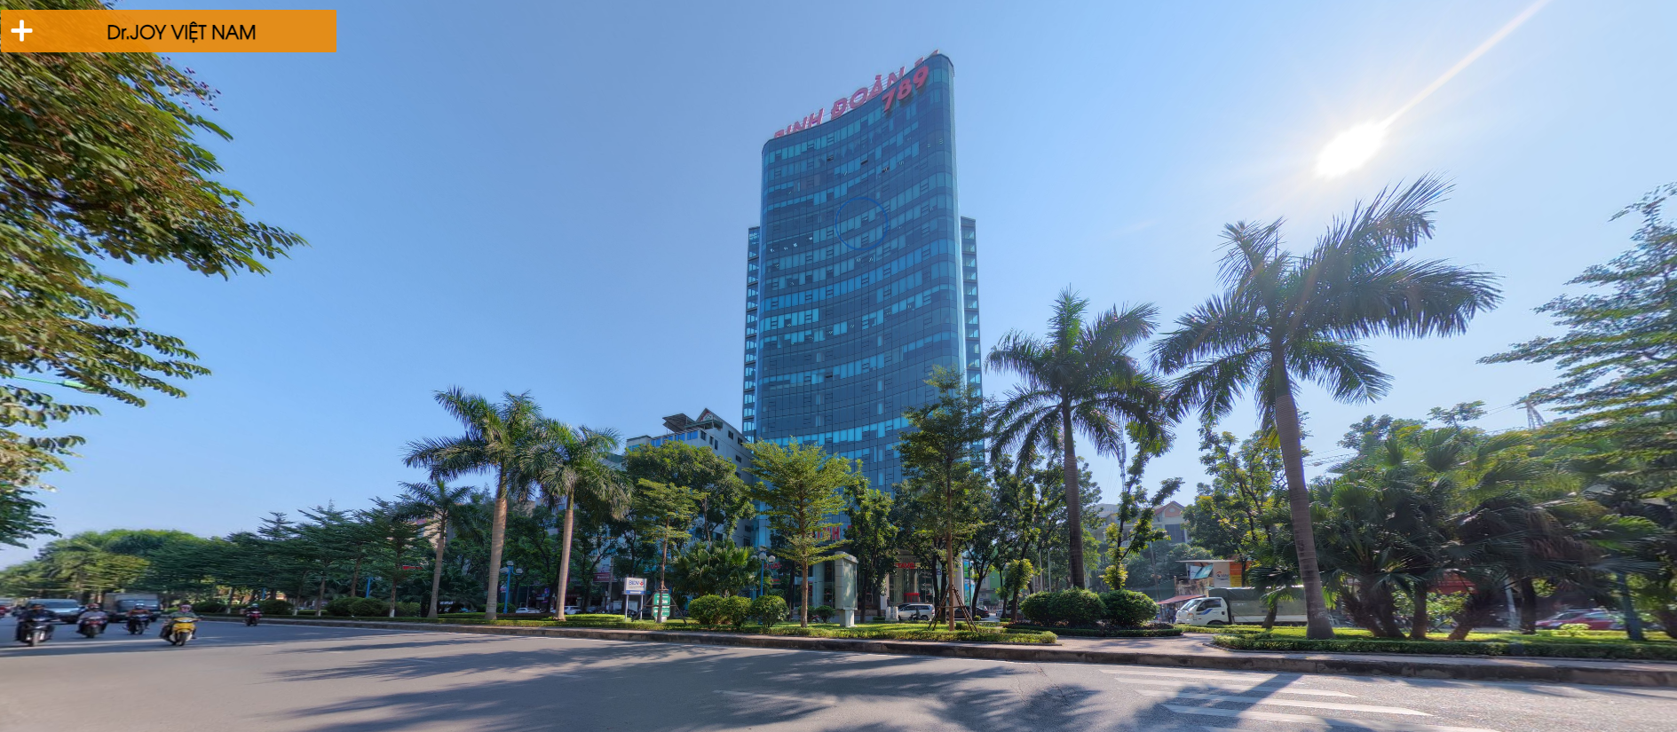
Our office
CLICK TO VIEW

Slide 8
Job opportunities
1
Senior Java Developer
Salary: Up to $2,000
<Scope of work>
・Design, code and test system or product's function after creating
・Create plan, implement and monitor development progresses
・Research new technology to apply into current projects
Your Skills and Experience
<Must have>
・Java (8 or more)：3 years or more
・Experience in creating basic design
・Experience in designing Database
・Ability to make highly maintainable code
・Object-Oriented Programming
<Nice to have>
・Spring boot / Spring framework
・gRPC(Protocol Buffers)
・Docker
・Kubernetes
・MongoDB

Slide 9
Job opportunities
3
Senior Android Developer
Salary: Up to $2,000
<Scope of work>
・Setup environment for development
・Study requirements, research technology related to project
・Handle Application Features
・Writing Unit Test
・Support & Maintenance (Testing & fixing Bugs)
Your Skills and Experience
・Experience in Android native development via using Kotlin: 3 years or above
・Experience in Reactive Programming（RxJava / RxAndroid)
・Experience with Firebase (FCM)
・Experience with MVP architecture
・Experience using Realm
<Nice to have>
・Experience with Dagger 2
・Experience in Fabric/Crashlytics
・Code review experience
・Test code implementation and test execution experience
・Experience with Cloud service environment (ex: GCP)

Slide 10
Hiring process
Online Interview
(by Division Manager)
Online Test
(at home)
Direct Interview
(by Japanese Director)

Slide 11
THANKS!
For further info, please take a look at what we are doing at:
https://www.youtube.com/watch?v=aQKX9A-xafs&feature=emb_logo
Send CV to: recruitment@drjoy.vn
Fanpage: https://www.facebook.com/DrJOYvietnam

